Slide 1
Oracle Goldengate Bigdata
Notes:
Option for introduction slide.

Slide 2
Vinay Tukaram Adivarekar.
Senior Database Consultant at Cegal.
More than 14 years of experience in various domains such as Banking, Energy, Finance, Shipping, Automobiles and Retail where working with managing infrastructure, security, cloud and cloud migration project.
More than 7 years of experience in Oracle Goldengate
Jon Petter Hjulstad
Principal Tech Sales at Cegal
More than 27 year's experience with Oracle Database and Middleware, and recently involved in Oracle Cloud projects.
Alumni's: Ace Associate and OUGN board

Slide 3
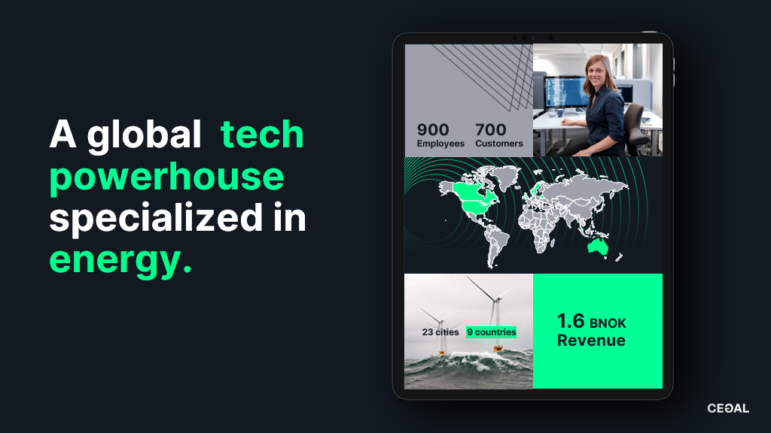
2025
Text
Text
Text
Text
Goal
Text
Text
Text
Text
Text
Text
Text
Text

Slide 4

Notes:
Option for introduction slide. The text is fixed

Slide 5
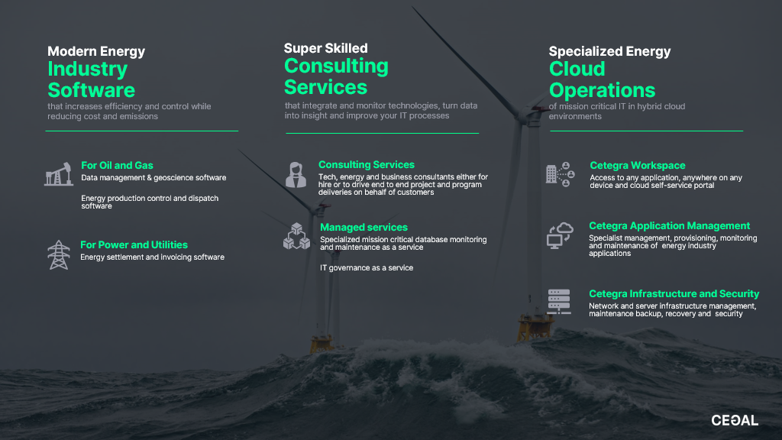
Notes:
Option for introduction slide. The text is fixed

Slide 6
Content
Introduction
Goldengate Bigdata Snowflake Business case Challenges
Solution
Notes:
Use this slide with one word, and the full stop punctuation in green.

Slide 7
Introduction
GoldenGate, replication and data-integration software developed by GoldenGate Software
GoldenGate company was founded in 1995 in San Francisco by Eric Fish and Todd Davidson.
Oracle Acquired GoldenGate in 2009.
Notes:
Use this slide with one word, and the full stop punctuation in green.

Slide 8
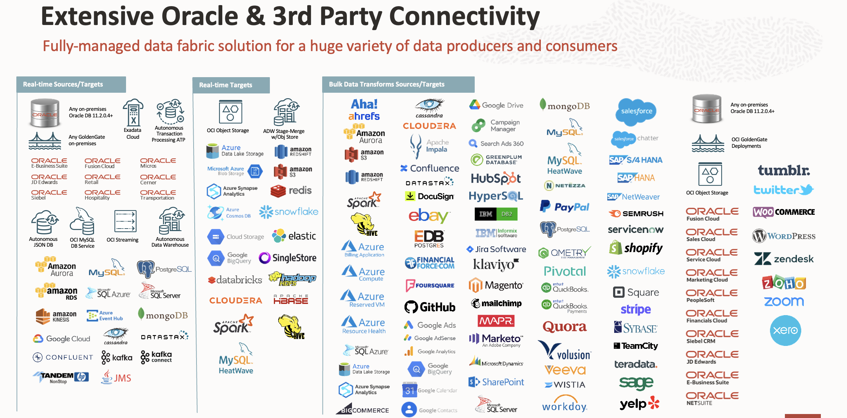
Connector Ecosystem
Notes:
Use this slide with one word, and the full stop punctuation in green.

Slide 9
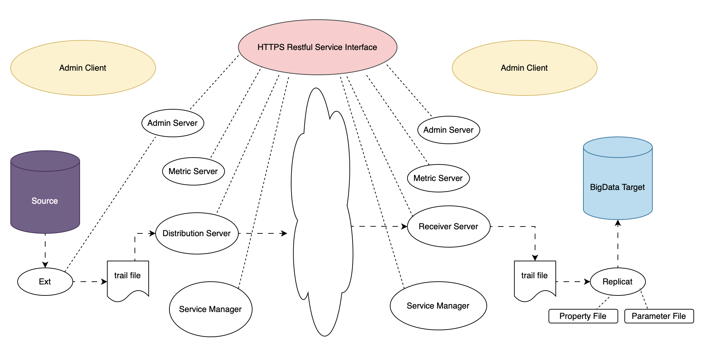
GoldenGate Bigdata
Captures real-time data from Bigdata system
Streams real-time changed data into Big Data systems
Automatic data transformation from row-oriented data format to nested or columnar data or compressed formats such as XML, JSON, Avro, Parquet, ORC etc.
Notes:
Use this slide with one word, and the full stop punctuation in green.

Slide 10
Snowflake
Authentication and Access Control
Cloud Service
Infrastructure
Management
Metadata
Management
Query Parsing and
Optimization
Security and Governance
Virtual Warehouse
Virtual Warehouse
Virtual Warehouse
Virtual Warehouse
Query Processing
Database
Database
Database
Data Storage
Notes:
Use this slide for short texts, like our vision. Use green highlight make words stand out, but not more than ca 20% of the text. “Our vision is to become a nextgen tech company that enables a more sustainable future.

Slide 11

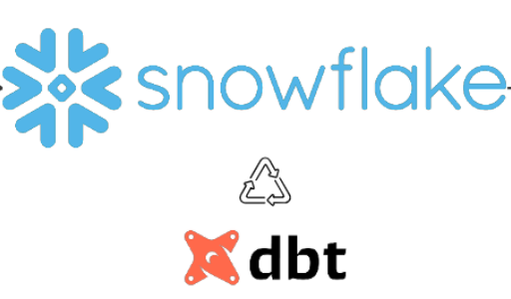
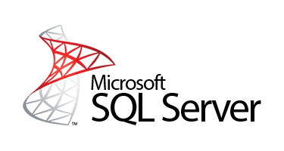

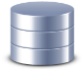
Business Case
Replication Tool
Notes:
Use this slide with one word, and the full stop punctuation in green.

Slide 12




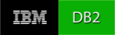




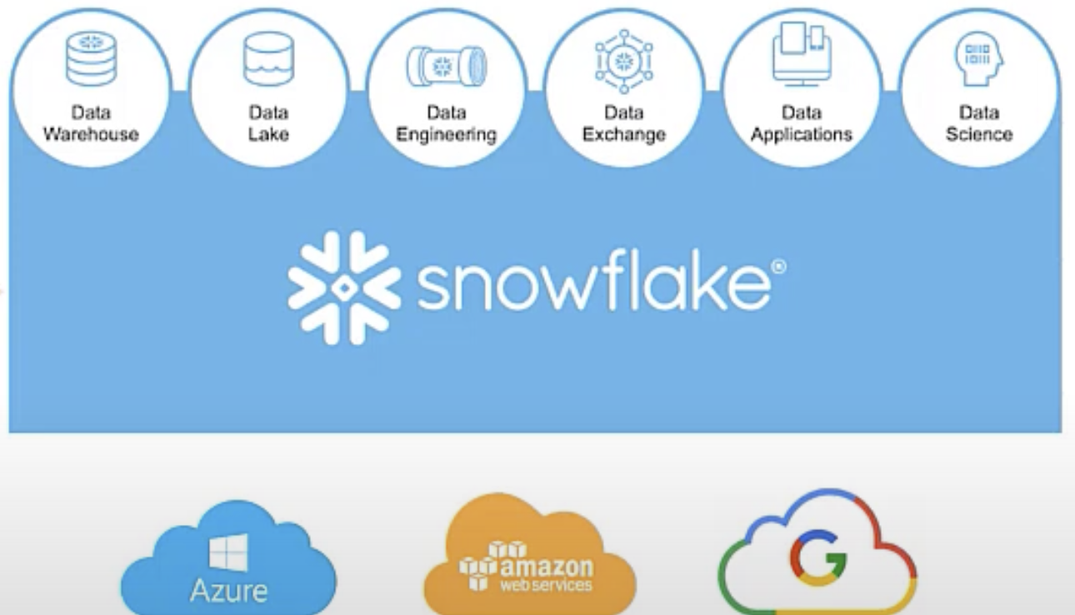







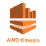











GoldenGate Replication to Snowflake
DB2/z
Relational
Non- Relational
OCI GoldenGate
Operation Aggregation
Apps
Notes:
Use this slide for short texts, like our vision. Use green font color to highlight words, but not more than ca 20% of the text. “Our vision is to become a nextgen tech company that enables a more sustainable future.

Slide 13
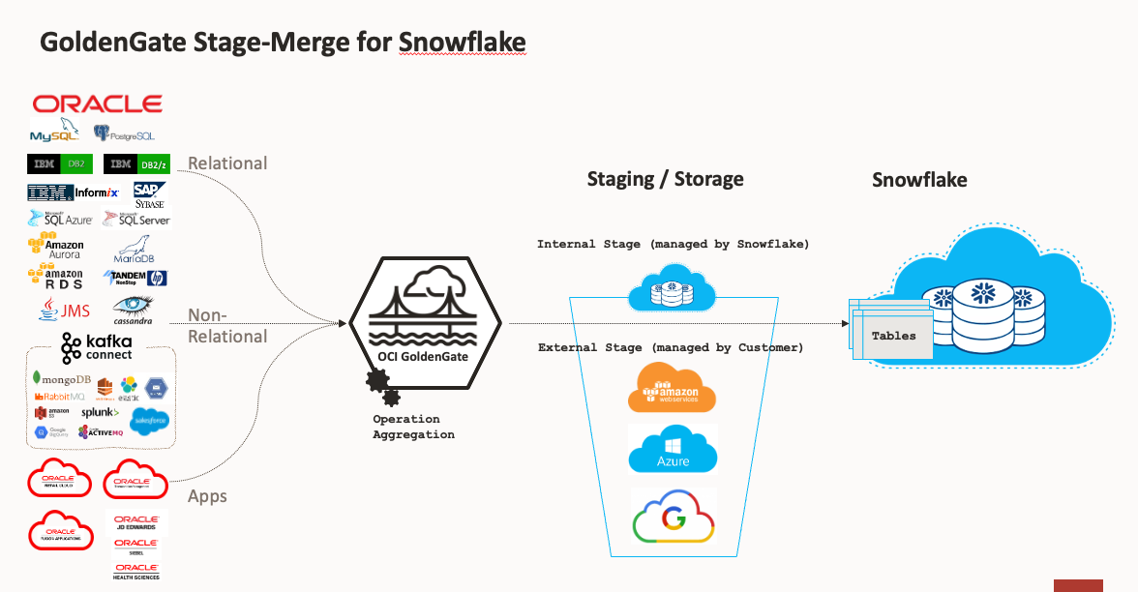
GoldenGate Staging for Snowflake
Internal Stage:
Managed by Snowflake.
Provides fast and efficient data loading from files stored within Snowflake.
External Stage:
References files stored externally in cloud storage services.
Enables data to be queried and loaded into Snowflake without physically moving it into Snowflake's storage.

Slide 14


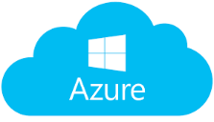


GoldenGate Staging for Snowflake
Trail Files
Delivery
Avro
Merge
2
Stage (every 30s)
Operation Aggregation
4
Avro
External Tables
1
3
Merge
Object Storage

Slide 15

Business Case: Technical Architecture
OCI Region Frankfurt
VCN
PRIV-SUB-TEST-DB
********
PRIV-SUB-TEST-APP
****
Oracle database
Oracle snowflake
GGS Deployment for oracle database
GGS Deployment for bigdata
Trail File
Trail File
Distribution Path
GoldenGate
GoldenGate
NAT
Gateway
AWS Snowflake
Notes:
Use this slide with one word, and the full stop punctuation in green.

Slide 16
DDL Sync (initial load)
Historization Of data
Challenges
Snowflake Cost
Access to Goldengate Console
Notes:
Use this slide with one word, and the full stop punctuation in green.

Slide 17
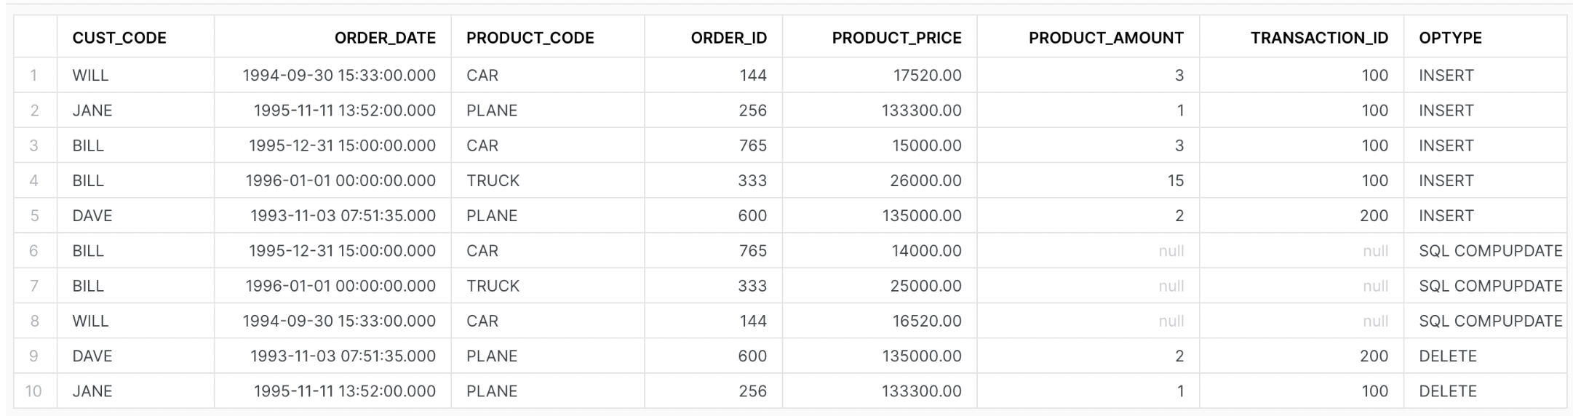
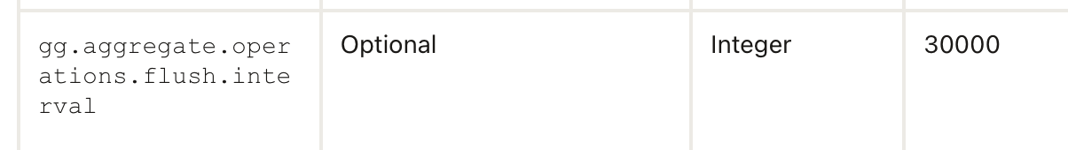
3rd Party Tools
Insertallrecord (multiple replicat)
Solution
Parameter for Bulk replication
IAM Integration
Notes:
Use this slide with one word, and the full stop punctuation in green.

Slide 18
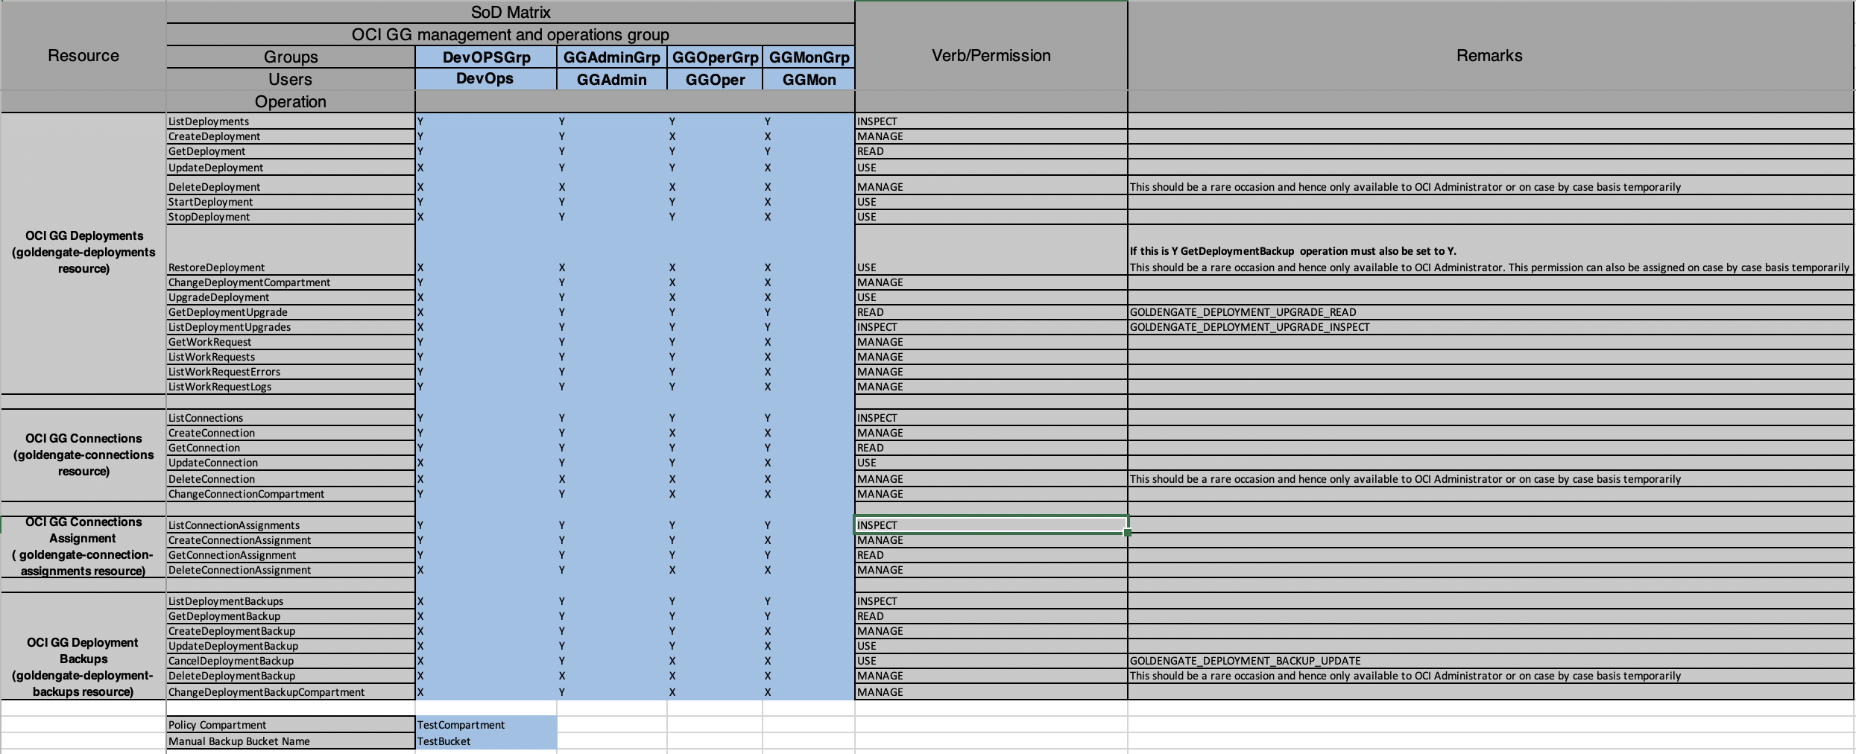
IAM Integration

Slide 19
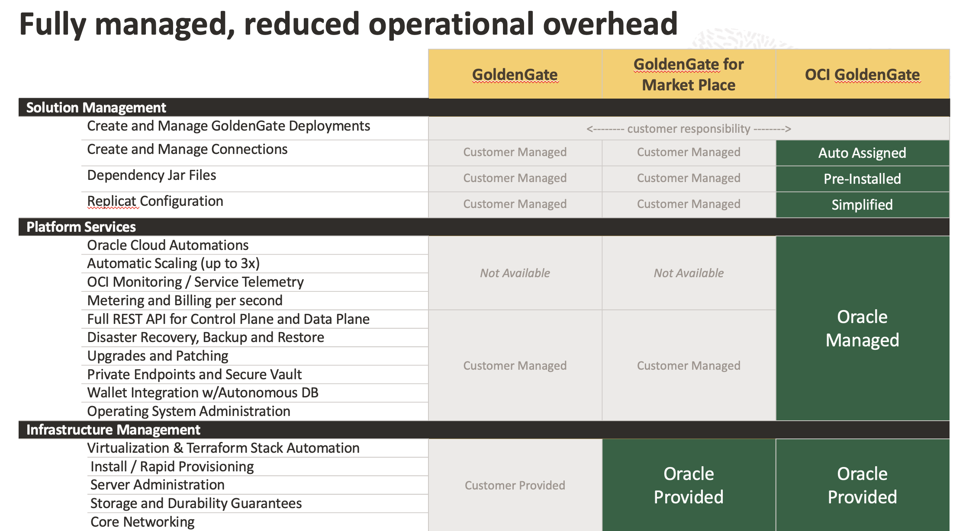
Advantages
OCI GoldenGate Bigdata is fully managed by Oracle.
Uses Oracle Xstream API to capture data from Oracle Database.
IAM Integration.
Multi-cloud support
Simpler with Microservice
Better Performance
More Reliable
Notes:
Use this slide with one word, and the full stop punctuation in green.

Slide 20
Thank you
vinay.tukaram.adivarekar@cegal.com
jon.petter.hjulstad@cegal.com

